Slide 1
ERC20 TOKEN

Slide 2
WHAT IS AN ERC20 TOKEN?
An ERC20 token represents a digital asset that can be owned, transferred, and traded on the Ethereum blockchain.
It follows a standardized set of rules, allowing for seamless integration and interoperability with other contracts and applications.

Slide 3
HOW IS AN ERC20 TOKEN MADE?
An ERC20 token is created by developing a smart contract that implements the ERC20 interface.
The contract defines functions for token transfers, balances, approvals, and other token-related operations.

Slide 4
INTRODUCTION
ERC20 is a standard interface for fungible tokens on the Ethereum blockchain.
It defines a set of rules and functions that a token contract must implement to be considered ERC20 compliant.
Notes:
Any token that implements these rules are ERC-20 compliant.

Slide 5
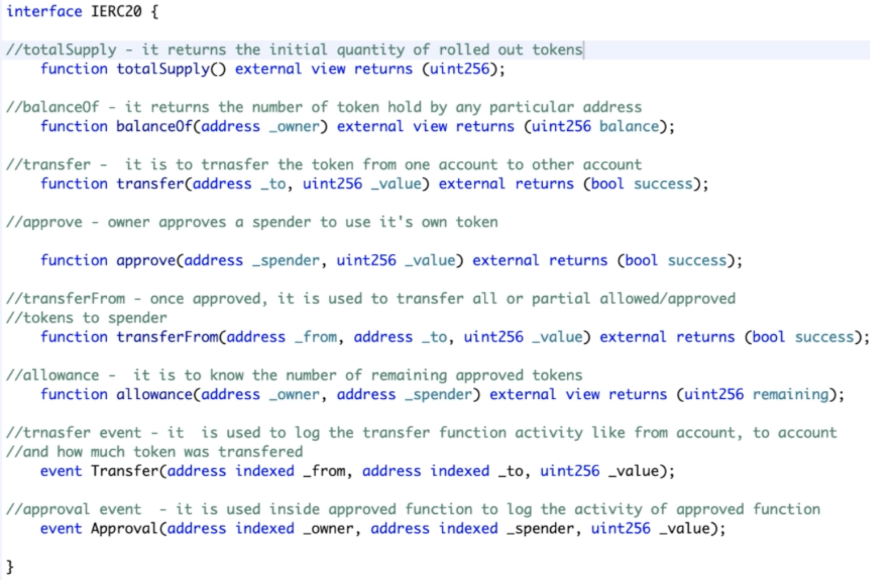
Interface
Notes:
Give Live demo on remix on how interface is implemented. ERC20 | Solidity by Example | 0.8.17 (solidity-by-example.org)

Slide 6
Quiz
What does the totalSupply() function in the IERC20 interface return?
a) The total number of tokens in existence
b) The total number of tokens an address owns
c) The total number of tokens that have been transferred
Notes:
Any token that implements these rules are ERC-20 compliant.

Slide 7
Quiz
What does the totalSupply() function in the IERC20 interface return?
a) The total number of tokens in existence
b) The total number of tokens an address owns
c) The total number of tokens that have been transferred
Notes:
Any token that implements these rules are ERC-20 compliant.

Slide 8
Quiz
What does the balanceOf(address account) function do?
a) It approves an account to spend tokens on behalf of the sender
b) It returns the amount of tokens that an account has
c) It transfers tokens from the sender to an account
Notes:
Any token that implements these rules are ERC-20 compliant.

Slide 9
Quiz
What does the balanceOf(address account) function do?
a) It approves an account to spend tokens on behalf of the sender
b) It returns the amount of tokens that an account has
c) It transfers tokens from the sender to an account
Notes:
Any token that implements these rules are ERC-20 compliant.

Slide 10
Quiz
What does the approve(address spender, uint amount) function do?
a) It transfers a certain amount of tokens to the spender
b) It sets a certain amount of tokens that the spender is allowed to spend on behalf of the owner
c) It checks how many tokens the spender has been approved to spend
Notes:
Any token that implements these rules are ERC-20 compliant.

Slide 11
Quiz
What does the approve(address spender, uint amount) function do?
a) It transfers a certain amount of tokens to the spender
b) It sets a certain amount of tokens that the spender is allowed to spend on behalf of the owner
c) It checks how many tokens the spender has been approved to spend
Notes:
Any token that implements these rules are ERC-20 compliant.

Slide 12
Quiz
What is the allowance(address owner, address spender) function used for?
a) It approves a spender to spend a certain amount of tokens on behalf of the owner
b) It transfers tokens from the owner to the spender
c) It returns the number of tokens the spender is allowed to spend on behalf of the owner
Notes:
Any token that implements these rules are ERC-20 compliant.

Slide 13
Quiz
What is the allowance(address owner, address spender) function used for?
a) It approves a spender to spend a certain amount of tokens on behalf of the owner
b) It transfers tokens from the owner to the spender
c) It returns the number of tokens the spender is allowed to spend on behalf of the owner
Notes:
Any token that implements these rules are ERC-20 compliant.

Slide 14
Quiz
What is the difference between Transfer and TransferFrom?
Notes:
Any token that implements these rules are ERC-20 compliant.

Slide 15
WHEN IS AN ERC20 TOKEN USED?
Tokenization of Assets: When there is a need to represent real-world assets as digital tokens on the blockchain.
Like USD (USDT, USDC).
Microsoft,Google,Apple stocks.
Crowdfunding: When projects or startups want to raise funds through token sales. (ICO)
Utility Tokens: When a token is used to access services or features within a decentralized application (DApp).
Notes:
$1.00 | Tether USD (USDT) Token Tracker | Etherscan

Slide 16
COMPARISON TO OTHER TOKENS
ERC20 vs. ERC721: ERC20 tokens are fungible (interchangeable) tokens, while ERC721 tokens are non-fungible tokens (unique and indivisible).
ERC20 vs. BEP20: ERC20 is the Ethereum standard, while BEP20 is the Binance Smart Chain equivalent.
ERC20 vs. Native Tokens: ERC20 tokens are built on top of the Ethereum blockchain, while native tokens are the native currency of a blockchain.

Slide 17
BENEFITS OF USING ERC20 TOKENS
Interoperability: ERC20 tokens can be seamlessly integrated with other contracts, wallets, and decentralized exchanges.
Standardization: The ERC20 standard ensures compatibility and ease of use across the Ethereum ecosystem.
Liquidity: ERC20 tokens can be easily listed and traded on various decentralized and centralized exchanges.

Slide 18
DOWNSIDES OF USING ERC20 TOKENS
Gas Costs: Interacting with ERC20 tokens requires gas fees, which can be costly during periods of high network congestion.
Lack of Control: ERC20 tokens rely on the underlying Ethereum network, and any network issues or vulnerabilities can affect their functionality.
Can’t do transfer/swap if no native tokens left in your wallet.

Slide 19
CONSIDERATIONS IN USING ERC20 TOKENS
Security: Careful attention must be paid to smart contract security to prevent vulnerabilities and potential token exploits.
Compliance: Regulatory considerations may arise when issuing and distributing ERC20 tokens, particularly in the context of securities laws.
Token Economics: Designing the token economics, supply, and distribution model requires careful planning and consideration.
Notes:
examples of compliance examples of Token economics

Slide 20
SUMMARY
ERC20 tokens are fungible tokens built on the Ethereum blockchain, following a standardized set of rules.
They find applications in fundraising, asset tokenization, and utility within decentralized applications.
ERC20 tokens offer interoperability, standardization, and liquidity, but also involve gas costs and reliance on the Ethereum network.

